Slide 1
MAR 580: Models for Marine Ecosystem-Based Management
TMB workshop
Session II
(Acknowledgements: Mollie Brooks, Kasper Kristensen, Arni Magnusson, Anders Nielsen, André Punt)
06 September 2022

Slide 2
Schedule
gavinfay.github.io/mebm-models/tmb
Rstudio Cloud project
Session I Questions?

Slide 3
When should I use TMB?
TLDR: when you need to.
Several packages that leverage TMB for calculations but don’t require you to program the C++ (knowing TMB might help with debugging).
{glmmTMB}
{sdmTMB}
{VAST}
TMB (or other custom model) might be needed for nonlinear latent variable dynamic models, and/or multiple observation models (multiple data types). TMB very good for models with lots of random effects (e.g. spatial models)
If you can dream it (and write your objective function), TMB can fit it?

Slide 4
TMBhelper package
Contains TMBAIC() function.
devtools::install_github("kaskr/TMB_contrib_R/TMBhelper")
Additional TMB contributed R packages available at
https://github.com/kaskr/TMB_contrib_R
(includes TMBphase to do phased estimation a la ADMB, and TMBdebug)

Slide 5
TMB Rstudio integration & code chunks
Some helpful code chunks:
https://github.com/kaskr/adcomp/wiki/Code--snippets
For Rstudio tmb snippets, and static code analyzer & more, use:
TMB:::setupRStudio()
Then restart Rstudio.

Slide 6
When are numerical methods used?
Main types of problems:
Differentiation
Integration
Interpolation / Extrapolation
Roots of equations
Solution of simultaneous equations
Nonlinear minimization
Matrix problems (nothing to do with Neo)

Slide 7
Calculus
Differentiation
How steep is the curve at point x?
Integration
How much area is under the curve between a and b?
a
b
x

Slide 8
Numerical integration
We wish to evaluate the integral:

Slide 9
Numerical integration: single step methods
We could approximate the integral by its height at its first point, at its last point, or at the middle.
Approximating the integral by the average of the first two approaches is the “Trapezoidal rule”.

Slide 10
Numerical integration
Trapezoidal rule: 0.68394
Simpson’s rule: 0.74718
Boole’s rule: 0.74683
Exact: 0.74682!

Slide 11
The error function, or how I learned to stop worrying & use someone else’s code.
Commonly required integral in fisheries is the “error function”:
Very accurate approximations to this integral have been programmed and are available in software libraries (e.g. NORMDIST in EXCEL, cumd_norm in ADMB, pnorm in R).
Someone may have already solved your problem; before writing your own code check if this is the case!

Slide 12
Mixed effects models

Slide 13
Linear modeling review LMs, GLMs, NLMs
LM and GLM are used to describe whether and how a response variable depends on a combination of predictors.
Predictors can be numeric (continuous) or factors (categorical).
Linear
Quite flexible as it is
Generalized
Any error distribution
Nonlinear
Any relationship between Y and X
closed form solution
iterative solution

Slide 14
What are Fixed and Random Effects?
Fixed Effects:
Parameters associated with the entire population or with certain repeatable levels of experimental units.
Random Effects:
Parameters associated with individual experimental units drawn at random from a population.
A mixed effects model is a model that has both fixed effects and random effects.
Classical (frequentist) and Bayesian methods can be used to estimate the parameters of mixed effects models.
Often the same random effect is assigned to observations sharing a common classification factor:
Consider length-at-age data for several (randomly selected) stocks of a species. The random factor is stock and the observations are length-at-age data.
Random effects can the thought of as ways of modeling the covariance structure of the data.

Slide 15
Linear Mixed Effects Models
Vector of fixed effects
Observations for group i
Vector of random effects
The traditional linear modeling framework is a special case of
of this model in which there are no random effects.

Slide 16
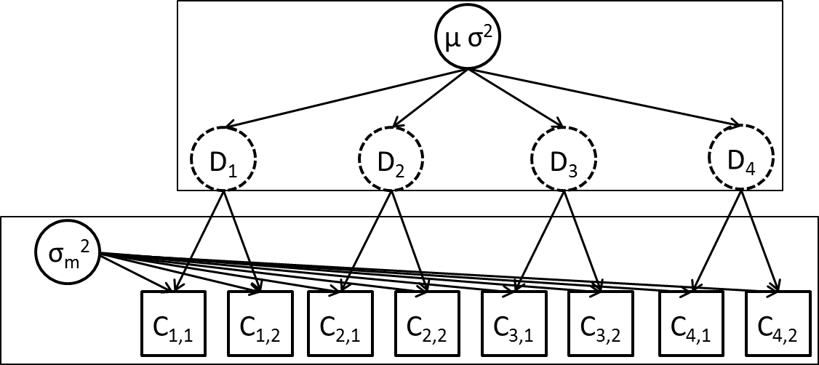
Example 1: Streams (sensu Pinherio and Bates, Chapter 1)
We are estimating fish density in streams.
We select six streams at random and determine the density at each stream three times.
The questions:
What is the density in a typical stream?
What is the variation in density among streams?
What is the variation in density estimates within a stream?
We would like to separately estimate measurement and between-site variability.

Slide 17
Example 1: Streams mixed effects model
We construct a mixed effects model as follows:
β is the mean density across the population,
b_{i} is a random variable representing the deviation from the population mean for stream i
ε_{i,j} is a random variable representing the deviation for observation j from mean density for stream i, i.e.

Slide 18
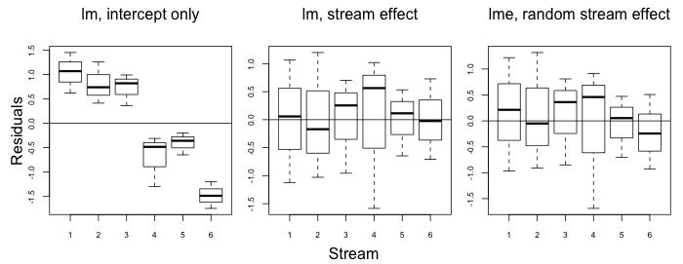
Fitting linear mixed effects models
These estimates are similar to the linear model with separate “stream effects” (but would not be if this was an unbalanced design).

Slide 19
Mixed Effects Models (Some notes)
Residuals are assumed to be independent, normally distributed random variables with constant variance.
Random effects are assumed to be normally distributed.
This only works if the streams have been selected at random from the population of streams.
Mixed effects models are also called hierarchical models.
This model has 3 parameters (β, σ and σ_{b}).
There are ways to estimate the random effects (we will often be interested in their values).

Slide 20
Estimation of mixed effects models
Maximum Likelihood Estimation (MLE)
is the vector of fixed effects parameters.
are the parameters controlling the distribution for the random effects.
We integrate across the random effects.
Effectively weight the probability of the observations given values for random effects by the probability of those values.
In the linear case, closed form solutions exist. For nonlinear models, we evaluate numerically or use approximations.

Slide 21
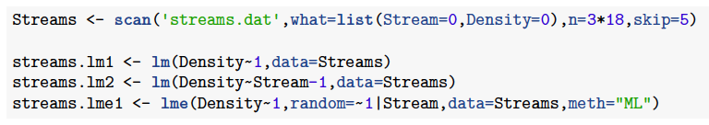
Estimating using R
lme() in package nlme, lmer() in lme4.
nlme() used to fit nonlinear models
The call to lme() first gives the fixed effects (the intercept in this case), and then the random component of the model.

Slide 22
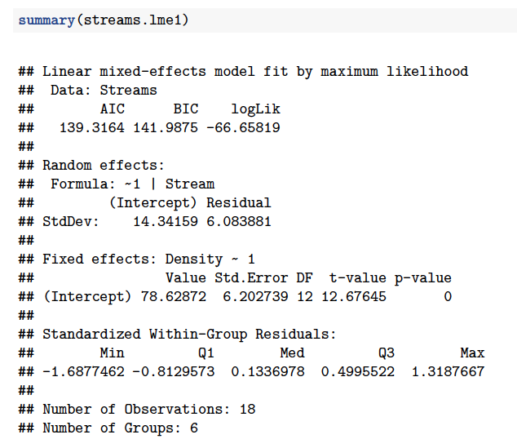
lme() output
among stream variation
within stream variation
fixed effects

Slide 23
Extending the linear mixed model
A non-linear relationship between the response variable and the covariates:
A non-normal distribution for the random effects.
A non-normal distribution for the within-group variability.

Slide 24
Non-linear Mixed Effects Models
Modeling age and length data for animals that are measured multiple times.
A meta-analysis for the parameters of the stock-recruitment relationship for many stocks.
A surplus production model with process and observation error.
An age-structured population dynamics model with recruitment variability (Stock Synthesis).

Slide 25
Fitting non-linear mixed effects models
R can be used to fit non-linear mixed effects models (function nlme).
To fit non-linear mixed effects models using TMB or EXCEL you need to evaluate the integral numerically, or apply a method such as the Laplace approximation.
is the value of ε obtained by maximizing given fixed values of θ and τ, and is the determinant of the matrix of second derivatives.
This approximation is exact when the distribution of random effects (given their hyper-prior and the available data) is exactly proportional to a multivariate normal distribution. (It is a convenient approximation in other cases)
Skaug & Fournier (2006), Thorson & Minto (2015)

Slide 26
Random effects in TMB
In MakeADFun, we add argument random
Names of parameters that are to be considered random effects
e.g. random=“stream”
Need to make sure we add the contribution to the likelihood function for the random effects in our .cpp file.

Slide 27
Streams model

Slide 28
Exercise: Poisson GLMM Summer flounder recreational catch per trip
We have data on the number of flounder caught on observed samples of angling trips across the Atlantic states. The number of sampled trips is uneven by state.
“summer_flounder_catch_per_trip.csv”
Fit a mixed-effects model for the catch per trip by state. Assume that the number of fish caught on a trip is Poisson distributed, with an intercept and a state-specific random effect. Report values for estimated parameters and their variance. Compare the fit to a model with a single intercept and no random effects for state.

Slide 29
Exercise: Growth estimation from lengths at release and recapture
Data set of bluegill recapture lengths
head(FSAdata::BluegillIL)
Laslett et al. (2002, CJFAS)
‘LEP’ method of estimating growth
Fit to Lengths at release/recapture instead of growth increment, time at liberty
Challenge: Growth models include Age, but these are not known!
Solution: Integrate across the age at release using random effects!

Slide 30
Parameters:
VBK Linf_mu
sigma_Linf
Sigma_obs
A_i (random effect)
Sigma_A
Mu_A
Data
Length 1
Length 2
dt
For each fish:
Mu_L1 (eq 3.5a)
Mu_L2 (eq 3.5b)
Sigma_L1 (eq 3.5c)
Sigma_L2 (eq 3.5d)
Cov_L1L2 (eq 3.5e)
MVNORM LIKELIHOOD

Slide 31
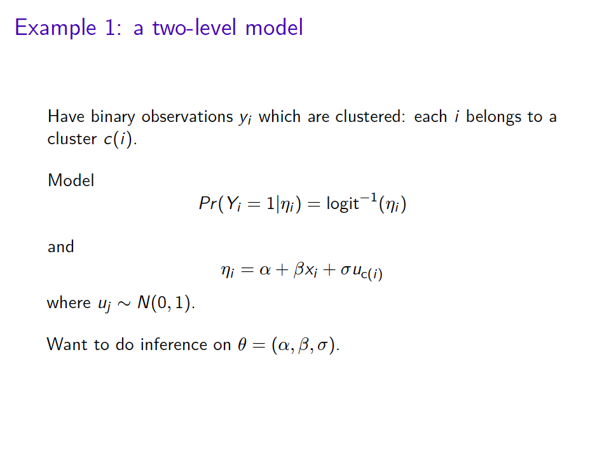

Slide 32
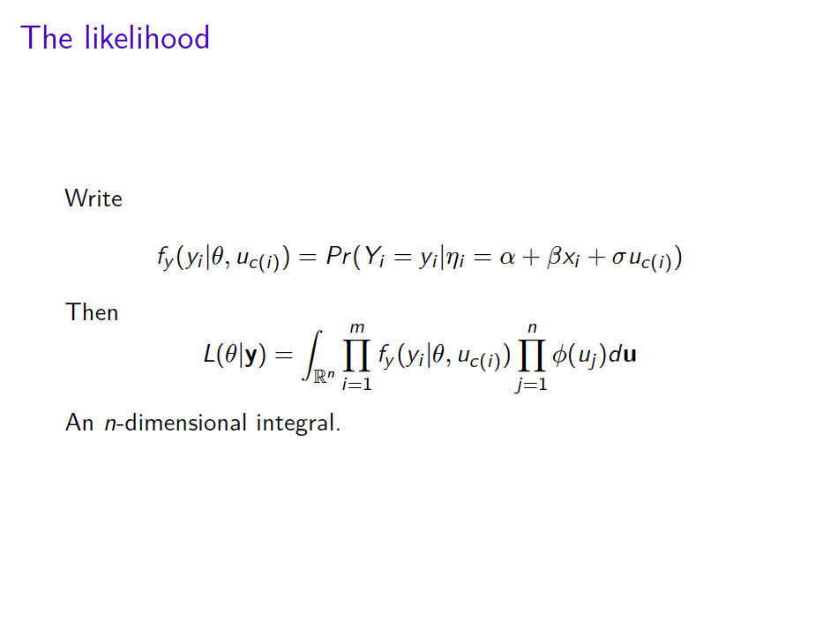

Slide 33
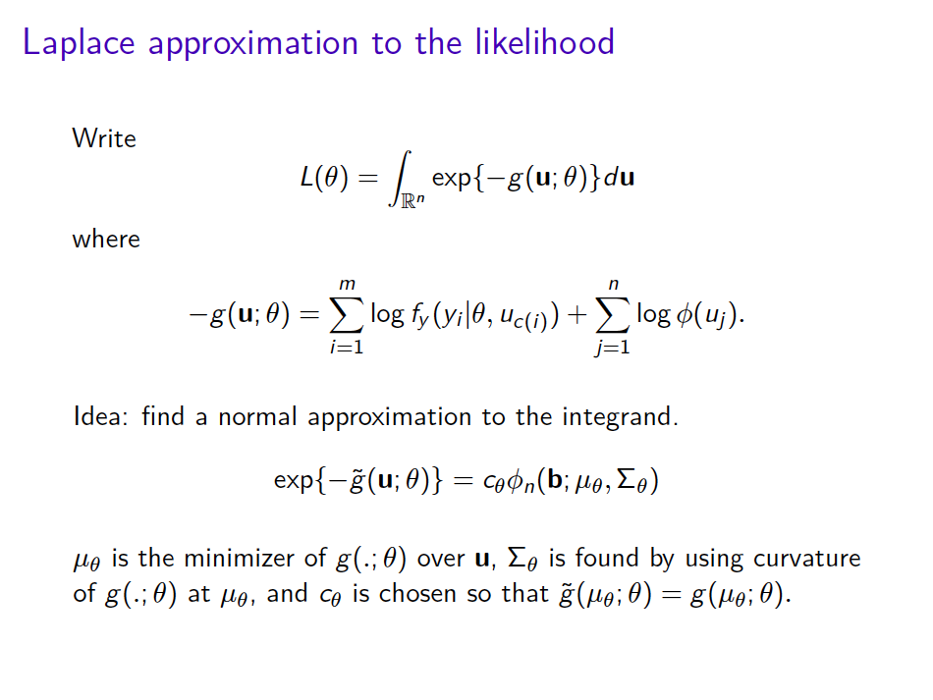

Slide 34
